Slide 1
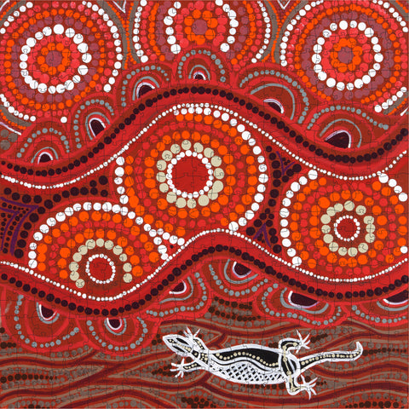
The Noongar Seasons – Page 1
Welcome to Western Australia, where the Noongar people have their unique calendar featuring six fascinating seasons. The seasons are Birak, Bunuru, Djeran, Makuru, Djilba, and Kambarang. The Noongar people determine the time of year by observing changes in the sun, moon, and Earth, instead of using a traditional calendar. Each season brings its unique signs in nature that the Noongar people have learned to read over countless generations.
How many seasons are there in the Noongar calendar? ___________________________________________________________________
What are the names of the Noongar seasons? ___________________________________________________________________ ___________________________________________________________________
How do the Noongar people determine the season? ___________________________________________________________________
Birak, the first season, is a time when the sun shines brightly, and the Earth is hot, quite like our summer. Then, Bunuru arrives, still hot but with a significantly larger and brighter moon. During these seasons, the Noongar people enjoy cool, breezy outdoors and partake in fishing activities. This engagement with nature has helped them shape their unique seasonal understanding over time.
What is the first season, and what is it like? ___________________________________________________________________
What happens during Bunuru? ___________________________________________________________________
How do the Noongar people know it’s Bunuru? ___________________________________________________________________

Slide 2
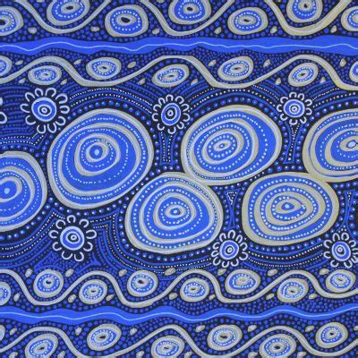
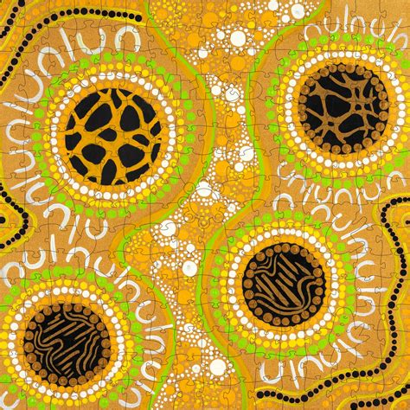
The Noongar Seasons – Page 2
The journey continues with Djeran, a season when the sun lowers, and the Earth starts to cool down, somewhat akin to autumn. Following Djeran is Makuru, the coldest season where the sun shines at its lowest, and nights can get frosty. The Noongar people savor the cool weather during these seasons and find ways to keep warm, marking the passage of time through these natural changes.
What is the third season, and what is it like? __________________________________________________________________
What happens during Makuru? __________________________________________________________________
How do the Noongar people know it’s Makuru? __________________________________________________________________
The Noongar calendar concludes with Djilba and Kambarang. Djilba sees the sun rising higher, and the Earth beginning to warm up. Then arrives Kambarang, a season of bright sunshine, warm Earth, and time for harvesting. During these seasons, the Noongar people relish the rejuvenation of nature and gather resources, subtly marked by changes in the Earth, sun, and moon.
What is the fifth season, and what is it like? __________________________________________________________________
What happens during Kambarang? __________________________________________________________________
How do the Noongar people know it’s Kambarang? __________________________________________________________________

